Slide 1
Tipping Points in Society
Peter De Ford
WAGER - Warwick Agents and Games in Economic Research April 21st, 2016

Slide 2
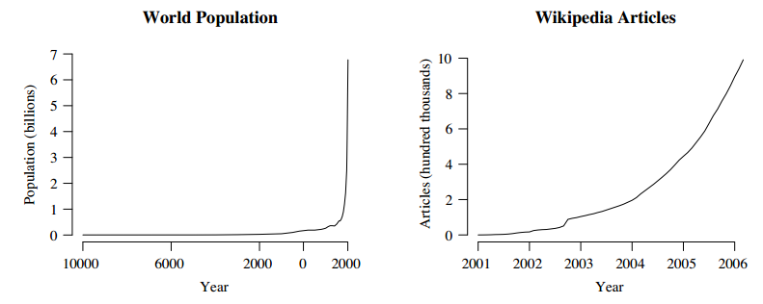
Tipping points in the media

Slide 3
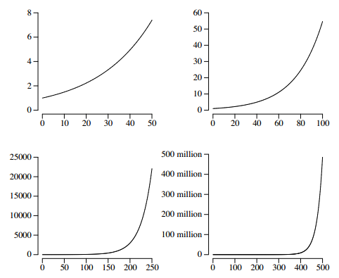
Ambiguity of tipping points in the media

Slide 4
Tipping points definition [5]
Rather than just exponential growth, tipping points are associated with unstable equilibriums, bifurcations and phase transitions (all of which may cause exponential growth)
Types: direct (i.e. Bandwagon process) and contextual
Definition: a point in time where a small change in a system variable modifies the system qualitatively, creating a dramatic effect in its state at some time in the future – not necessarily immediately

Slide 5
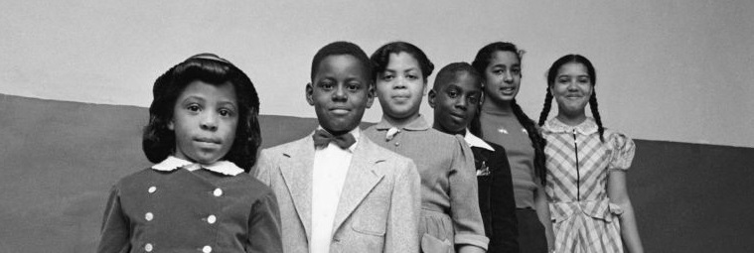
Tipping points in society: origin of the concept
Morton Grodzins study in U.S. neighbourhoods
He discovered that most of the white families remained in the neighbourhood as long as the comparative number of black families remained very small. But, at a certain point, when too many black families arrived, the remaining white families would move out en masse in a process known as white flight. He called that moment the "tipping point“ [1]

Slide 6
Agenda
Part I: Tipping points in charging systems
1. Social epidemics (Gladwell [2])
2. Dissemination of culture model (Axelrod [3])
3. Society as a self-organized critical system (Kron and Grund [4])
Part II: Landscapes in charging systems
4. Charge landscapes and avalanche landscapes
5. Applications of landscapes

Slide 7
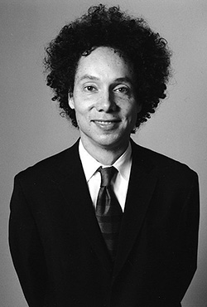
1. Social Epidemics
NY Times bestseller in year 2000
Malcolm Gladwell

Slide 8
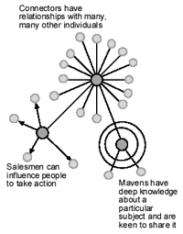
1.1 Gladwell’s social epidemics rules
People: The law of the few
Mavens, connectors and salesmen
Infection: The stickiness factor
Environment: The power of context

Slide 9
1.2 Making an ABM model from Gladwell’s ideas
Parameters of the model:
People
Number of people, network type, average node degree, percentages and locations of mavens, connectors and salesmen, susceptibility of population
Infection
Stickiness, charge th, interactions th, cut-interactions, recover capacity, time of infection, immunity
Environment
Parameters are implicit in the above ones

Slide 10
1.3 Programming the model

Slide 11
1.4 Case: Hush puppies (Law of the few)
“Hollywood” network type

Slide 12
1.4 Case: Hush puppies (law of the few)

Slide 13
1.5 Case: Sesame street and C-C (stickiness factor)

Slide 14
1.5 Case: Sesame street and C-C (stickiness factor)

Slide 15
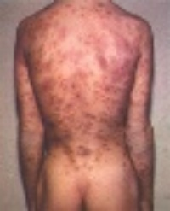
1.6 Case: Syphilis in Baltimore (power of context)
3 little causes
Less doctors
More drugs → more sex
Displaced people

Slide 16
1.6 Case: Syphilis in Baltimore (power of context)

Slide 17
2. Axelrod model of dissemination of culture
Paper: “The Dissemination of Culture: a model with local convergence and global polarization”, by Axelrod [3]
Axelrod: “If people tend to become more alike in their beliefs, attitudes and behaviour when they interact, why do not all such differences eventually disappear?”
So he created a model to explain the above question based on the following two premises
1. People are more likely to interact with others who share many of their cultural attributes
2. Interactions between two people tend to increase the number of attributes they share

Slide 18
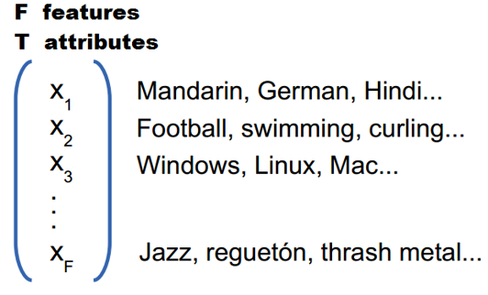
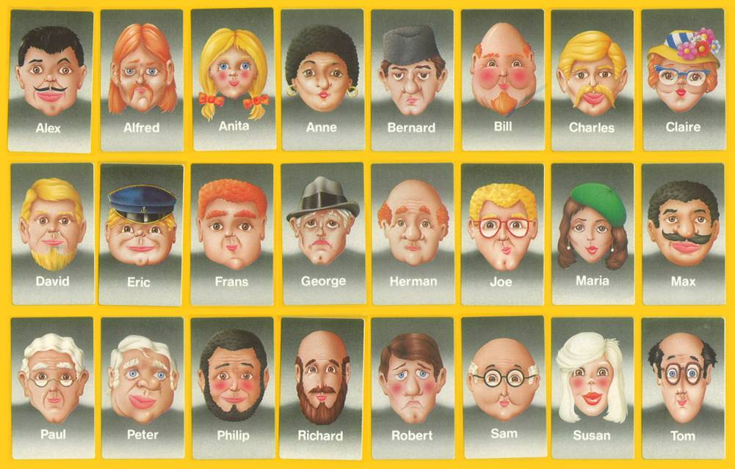
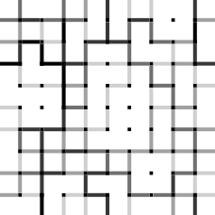
2.1 Defining the model

Slide 19
2.2 Observing average number of stable regions

Slide 20
2.3 Running the model

Slide 21
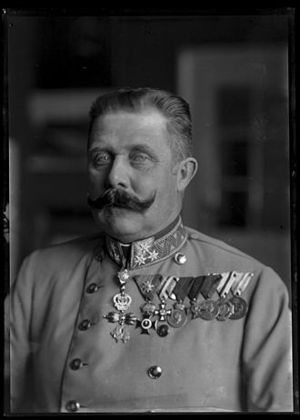
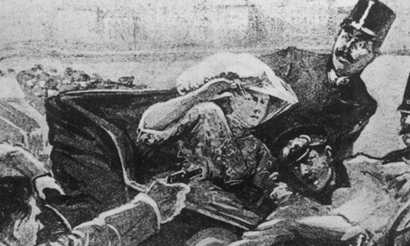
3. Self-organized criticality
Paper: “Society as a Self-Organized Critical System” by Kron and Grund [4]
Quotes from the paper:
Modern society can be seen as a self-organized critical system that endogenously reaches critical states. Small or large breakdowns can be caused by single events
The model of self-organized criticality can be used to show how the permanent addition of energy (political power) to a close coupled system (of nations) can result in positive feedback loops. Doing so, we can explain how a single “historical grain of sand” (the assassination in Sarajevo of Archduke Franz Ferdinand) was able to trigger an apocalyptic “avalanche of warlike actions” with more casualties than ever before

Slide 22
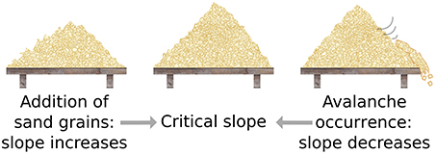
3.1 Sand-pile model

Slide 23
3.2 Self-organized criticality in society
More quotes from the paper:
The pile self-organizes and builds up an increasingly complex structure. At some point all non-disruptive locations that do not cause the collapse of the system are occupied (the system is over-critical)
We do not need an explanation for how the single historical event of the assassination resulted in WWI, but we need a macro-sociological explanation for the critical state that made such a series of events possible (avalanche landscape)

Slide 24
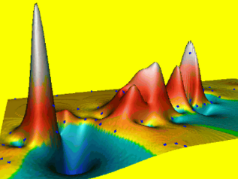
4. Charge and avalanche landscapes
What the 3 examples given have in common?
A global contextual tipping point makes the system to begin charging. Then small changes (direct tipping points) cause avalanches through charged elements
When things seem to be stable they may be not, perhaps a hidden tipping point happened that made the system to begin charging and then a small change can cause an avalanche
Landscapes
Landscapes are ‘kind of’ a simple way of studying the GlobalContextualTippingPoint→SystemCharging→DirectLocalTippingPointAvalanche(s) phenomena in networked and spatial systems
Charge landscapes can be made and used to create avalanche landscapes. Then avalanche landscapes can be used to get a general overview of the potential avalanches in order to attenuate or amplify avalanches

Slide 25
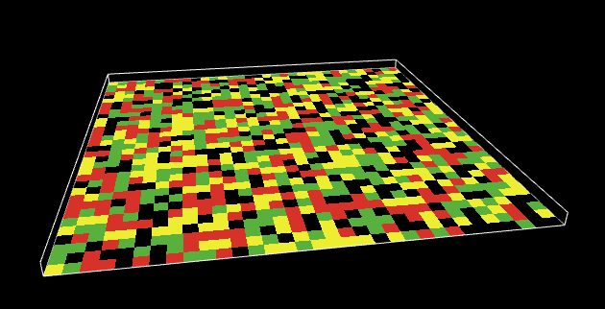
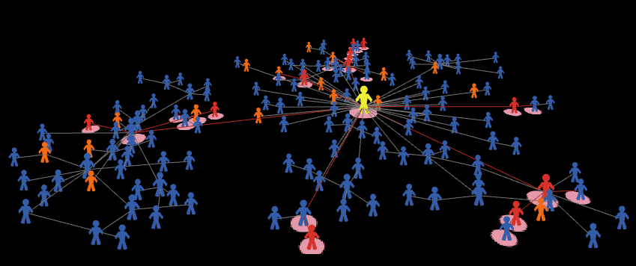
4.1 Charge landscapes

Slide 26
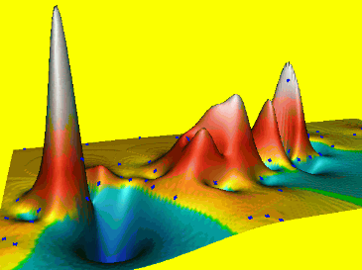
4.2 Avalanche landscapes
For deterministic systems, calculate or estimate sizes of avalanches in charge landscape. For stochastic systems, calculate or estimate expected values of avalanche sizes
Great visual tools for explaining tipping points to non-technical audiences

Slide 27
5. Applications of landscapes
Applications of landscapes in networked systems:
Networks of people: fashion, digital marketing, infectious diseases, riots (i.e. Arab Spring)
Networks of organizations: state creation, transnational integration, wars, financial crisis
Applications of landscapes in spatial systems:
Development: one variable can make a tipping point in other
Urban planning: urban racial segregation (Schelling model)
Behavioural economics nudges: create simple policies (tipping points) that make big change in society (i.e theory of broken windows)

Slide 28
References
[1] Tipping points (Sociology), Wikipedia
[2] The Tipping Point, Malcolm Gladwell, 2000
[3] The Dissemination of Culture: a model with local convergence and global polarization, Robert Axelrod, The Journal of Conflict Resolution, Vol. 41. Issue 2 (April 1997)
[4] Society as a Self-Organized Critical System, Thomas Kron and Thomas Grund, Cybernetics and Human Knowing, Vol.16
[5] Tipping points, P. J. Lamberson and S. E. Page, Sante Fe Institute working paper 2012-02-002

